Slide 1

Let’s become Spiderman

Slide 2
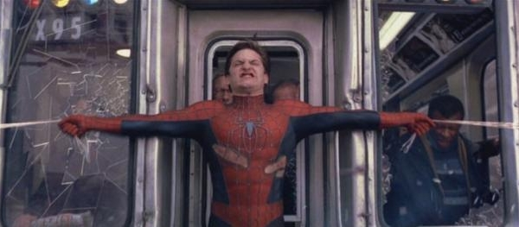
Can a Spiderman stop a train?

Slide 3
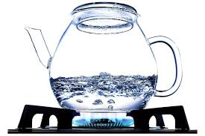
Can somebody explain how a liquid attains its boiling point?

Slide 4
The water will boil or turn to vapour as soon as its internal vapour pressure equals the pressure exerted on it by the atmosphere. When that occurs, bubbles begin to form and the water boils.
Discussion
Atmospheric pressure
Internal vapour pressure

Slide 5
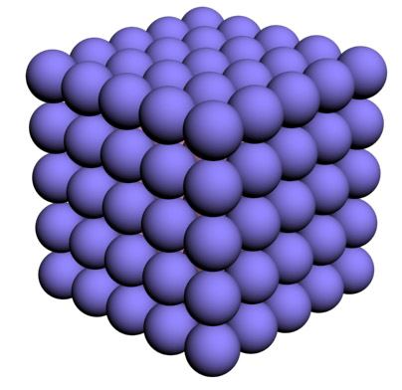
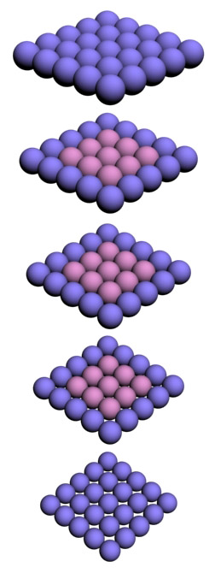
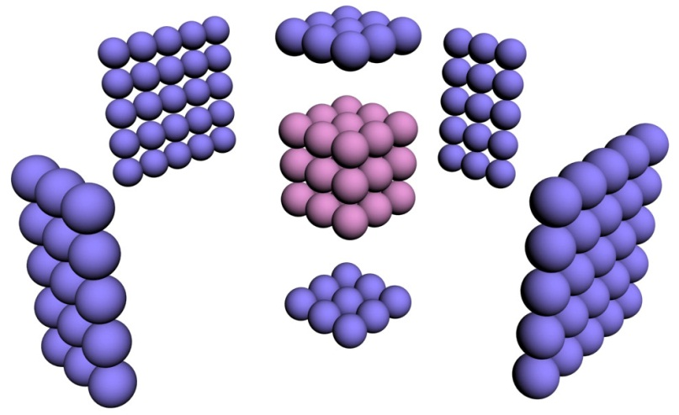
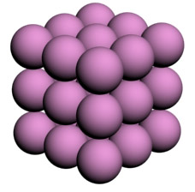
Faces are key to behaviour

Slide 6
Considering Hydrogen atom (radius = 0.05 nm)
n (atoms on edge) | N = n³ (total atoms) | % atoms on surface | Size of cube
10⁷ | 10²¹ | 0.00006 | 1 mm
10⁴ | 10¹² | 0.06 | 1 μm
500 | 125x10⁶ | 1.2 | 50 nm
100 | 10⁶ | 5.8 | 10 nm
10 | 10³ | 50 | 1 nm
5 | 125 | 80 | 0.5 nm

Slide 7
Exploring Nano:
a Pedagogical Journey

Slide 8
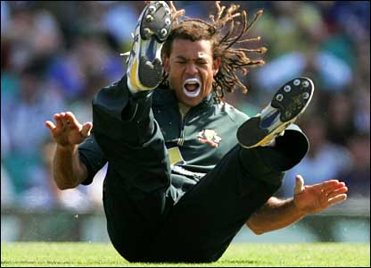

Sunscreen Lotion
Titanium oxide
Zinc oxide

Slide 9
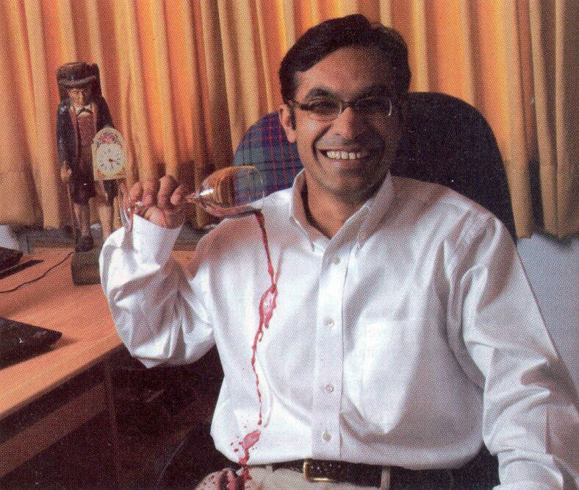
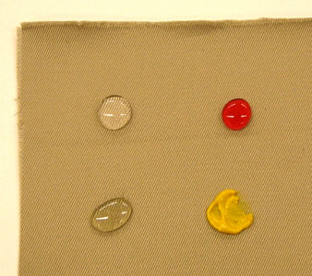
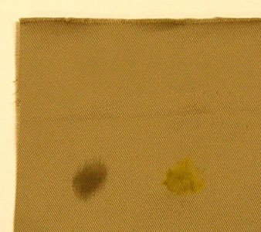
Stain free,
Water resistant fabric

Slide 10
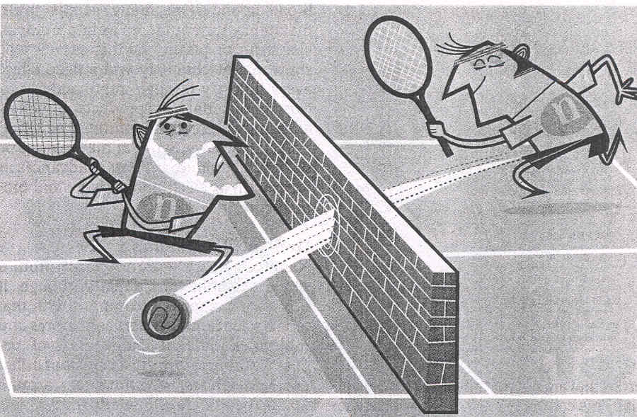
Expect the Unexpected

Slide 11
What is Nanotechnology?

Slide 12
Understanding Effects
Centimeter: Gravity, friction, combustion
Millimeter: Gravity, friction, combustion, electrostatic
Micrometer: Electrostatic, van der Walls, Brownian
Nanometer: Electrostatic, van der Walls, Brownian, Quantum
Angstrom: Quantum mechanics
(1/10,000,000,000 meter)

Slide 13
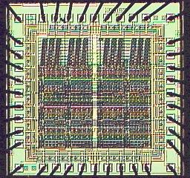
Nanotechnology is all about
Arranging Atoms
Do you recognize this structure?
Diversity
Precision
Cost

Slide 14
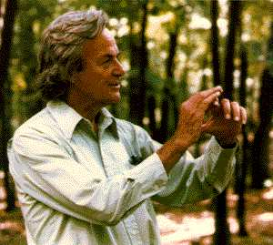
Richard Feynman,1959
(the great visionary)
There’s plenty of room
at the bottom

Slide 15
The principles of Physics, as far as I can see, do not speak against the possibility of maneuvering things atom by atom.
Richard P. Feynman

Slide 16
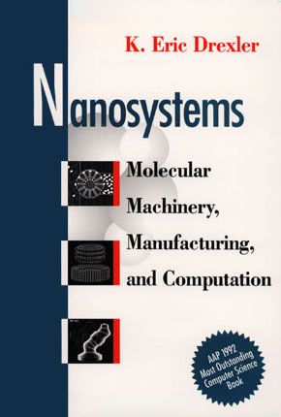
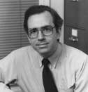
Eric Drexler, 1992
(the great pioneer)

Slide 17
Nanotechnology is the principle of atom manipulation atom by atom, through control of the structure of matter at the molecular level. It entails the ability to build molecular systems with atom-by-atom precision, yielding a variety of nanomachines.
Eric Drexler

Slide 18
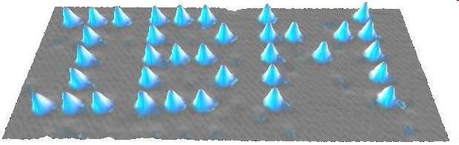
Manipulation Atom-by-Atom
IBM
35 Xe atoms put together on nickel
Don Eigler (IBM, California), 1989
Became the 1st person to move atoms

Slide 19
Nanotechnology is concerned with developing the tools for characterizing and manipulating materials on nanoscale (1-100 nm) and exploiting these tools for the development of new products and processes.

Slide 20
Narrow definition: at least 2 dim are below 100 nm
Extended definition: one dimension below 100 nm and a second dimension below 1 μm.

Slide 21
Nanostructure
Based on their geometrical dimension with reference to an external reference system, viz., substrate.
Nanodevice
At least one functional component is a nanostructure.
Nanosystem
Consists of several nanodevices that are of importance for the functioning of the whole system.

Slide 22

Advantages of
starting from “small things”
you can dissolve sugar or salt quicker when it is in powder form and slower when it is in the form of crystals or blocks
smaller can become more reactive

Slide 23
Advantages of
starting from “small things”
Properties can be altered as desired
More precision
Less waste

